Slide 1


Robin Singh
19/05/2025

Slide 2

Outline
Executive Summary
Introduction
Methodology
Results
Conclusion
Appendix

Slide 3
Executive Summary
Summary of methodologies
Data Collection through API
Data Collection with Web Scraping
Data Wrangling
Exploratory Data Analysis with SQL
Exploratory Data Analysis with Data Visualization
Interactive Visual Analytics with Folium
Machine Learning Prediction
Summary of all results
Exploratory Data Analysis result
Interactive analytics in screenshots
Predictive Analytics result

Slide 4
Introduction
Project background and context
Space X advertises Falcon 9 rocket launches on its website with a cost of 62 million dollars; other providers cost upward of 165 million dollars each, much of the savings is because Space X can reuse the first stage. Therefore, if we can determine if the first stage will land, we can determine the cost of a launch. This goal of the project is to create a machine learning pipeline to predict if the first stage will land successfully.
Questions to be answered
- How do variables such as payload mass, launch site, number of flights, and orbits affect the success of the first stage landing?
- Does the rate of successful landings increase over the years?
- What is the best algorithm that can be used for binary classification in this case ?

Slide 5


Slide 6
Methodology
Executive Summary
Data collection methodology:
Data was collected using SpaceX API and web scraping from Wikipedia.
Perform data wrangling
One-hot encoding was applied to categorical features
Perform exploratory data analysis (EDA) using visualization and SQL
Perform interactive visual analytics using Folium and Plotly Dash
Perform predictive analysis using classification models
How to build, tune, evaluate classification models

Slide 7
Data Collection
The data was collected using various methods
Data collection was done using get request to the SpaceX API.
Next, we decoded the response content as a Json using .json() function call and turn it into a pandas dataframe
We then cleaned the data, checked for missing values and fill in missing values where necessary.
In addition, we performed web scraping from Wikipedia for Falcon 9 launch records with BeautifulSoup.
The objective was to extract the launch records as HTML table, parse the table and convert it to a pandas dataframe for future analysis.

Slide 8
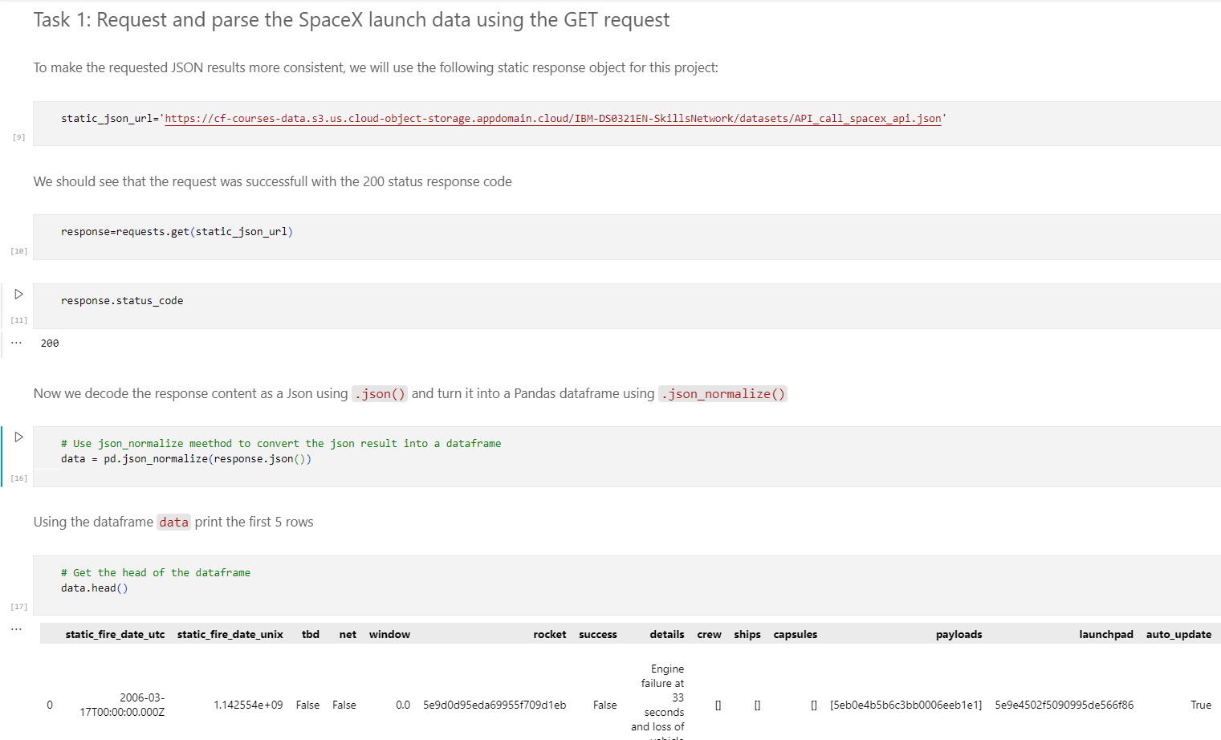
Data Collection – SpaceX API
We used the get request to the SpaceX API to collect data, clean the requested data and did some basic data wrangling and formatting.
The link to the notebook is https://github.com/RobinSingh410/IBM_Data_Science_Capstone.git

Slide 9
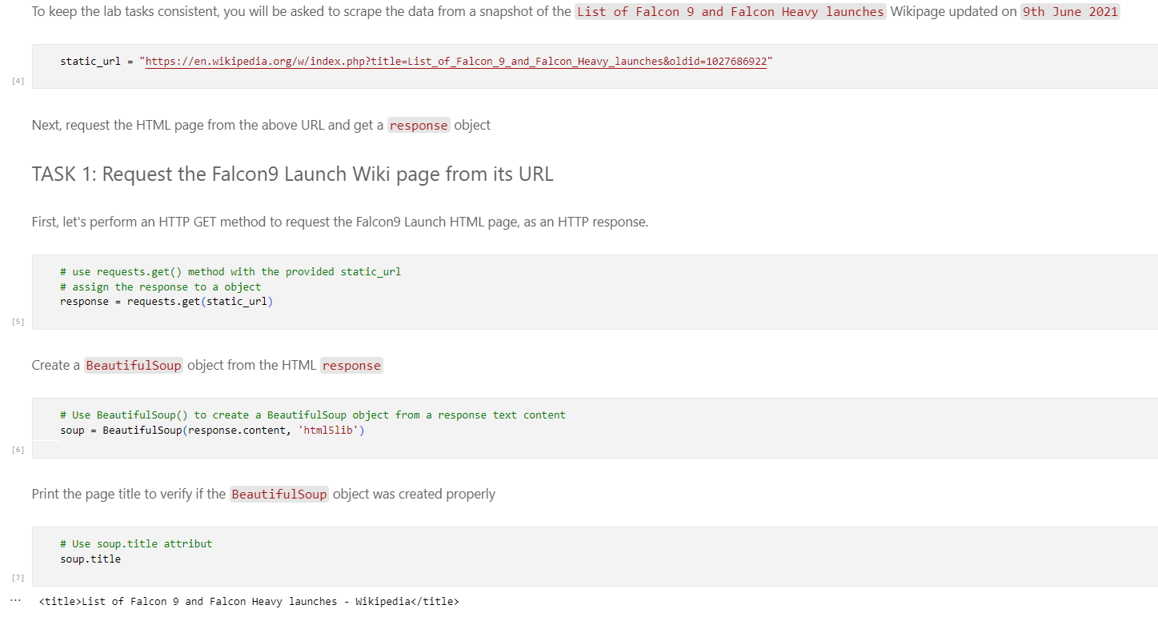
Data Collection - Scraping
We applied web scrapping to webscrap Falcon 9 launch records with BeautifulSoup
We parsed the table and converted it into a pandas dataframe.
The link to the notebook is https://github.com/RobinSingh410/IBM_Data_Science_Capstone.git

Slide 10

Data Wrangling
We performed exploratory data analysis and determined the training labels.
We calculated the number of launches at each site, and the number and occurrence of each orbits
We created landing outcome label from outcome column and exported the results to csv.
The link to the notebook is https://github.com/RobinSingh410/IBM_Data_Science_Capstone.git

Slide 11

EDA with Data Visualization
We explored the data by visualizing the relationship between flight number and launch Site, payload and launch site, success rate of each orbit type, flight number and orbit type, the launch success yearly trend, Launch success yearly trend
For visualization we have used scatter plot , bar plot , line plot .
Github link : https://github.com/RobinSingh410/IBM_Data_Science_Capstone.git

Slide 12
EDA with SQL
We applied EDA with SQL to get insight from the data. We wrote queries to find out for instance:
The names of unique launch sites in the space mission.
The total payload mass carried by boosters launched by NASA (CRS)
The average payload mass carried by booster version F9 v1.1
The total number of successful and failure mission outcomes
The failed landing outcomes in drone ship, their booster version and launch site names.
Github link : https://github.com/RobinSingh410/IBM_Data_Science_Capstone.git

Slide 13
Build an Interactive Map with Folium
We plotted all launch sites on the Folium map and incorporated various map elements like markers, circles, and lines to visually represent the success or failure of launches at each location.
The launch outcomes were categorized into two classes: 0 for failure and 1 for success.
By utilizing color-coded marker clusters, we analyzed which launch sites demonstrated a higher success rate.
We measured the distances between launch sites and their surrounding infrastructure. Additionally, we explored key questions such as::
Are launch sites located near railways, highways, or coastlines?
Do launch sites maintain a specific distance from cities?

Slide 14
Build a Dashboard with Plotly Dash
We developed an interactive dashboard using Plotly Dash.
A pie chart was created to visualize the total number of launches at each site.
A scatter plot was generated to examine the relationship between launch outcomes and payload mass (Kg) across different booster versions.
Github link : https://github.com/RobinSingh410/IBM_Data_Science_Capstone.git

Slide 15
Predictive Analysis (Classification)
We loaded and processed the data using NumPy and pandas, followed by data transformation and splitting into training and testing sets.
Multiple machine learning models were built, and hyperparameters were optimized using GridSearchCV.
Accuracy was used as the primary evaluation metric, and we enhanced the model through feature engineering and algorithm tuning.
The best-performing classification model was identified based on its performance.
Github link : https://github.com/RobinSingh410/IBM_Data_Science_Capstone.git

Slide 16
Results
Exploratory data analysis results
Interactive analytics demo in screenshots
Predictive analysis results

Slide 17


Slide 18
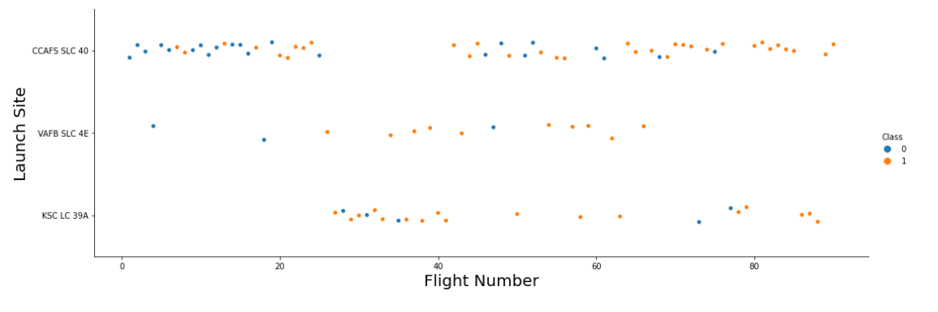
Flight Number vs. Launch Site
The earliest flights all failed while the latest flights all succeeded.
• It can be assumed that each new launch has a higher rate of success.

Slide 19
Payload vs. Launch Site
For every launch site the higher the payload mass, the higher the success rate

Slide 20
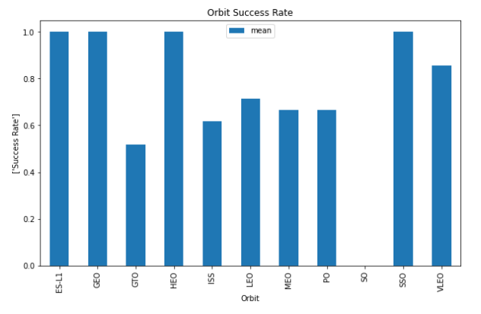
Success Rate vs. Orbit Type
Orbits with 100% success rate:
ES-L1, GEO, HEO, SSO
• Orbits with 0% success rate:
- SO

Slide 21
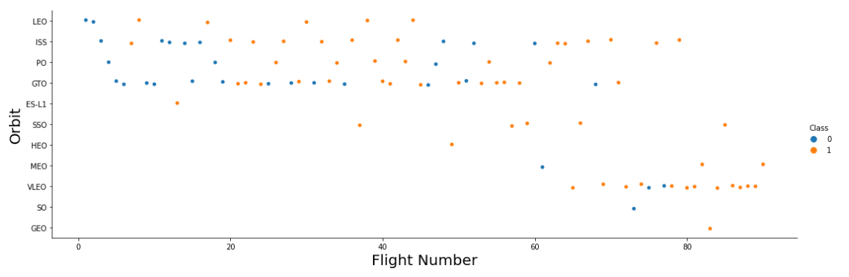
Flight Number vs. Orbit Type
We observe that in the LEO orbit, success is related to the number of flights whereas in the GTO orbit, there is no relationship between flight number and the orbit.

Slide 22
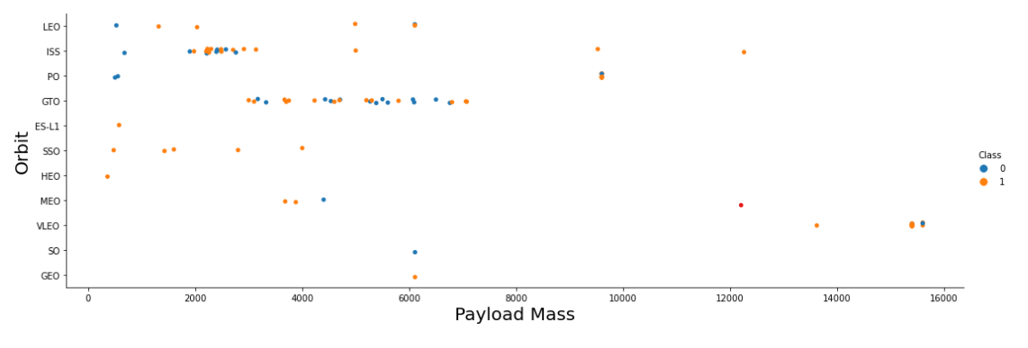
Payload vs. Orbit Type
We can observe that with heavy payloads, the successful landing are more for PO, LEO and ISS orbits.

Slide 23
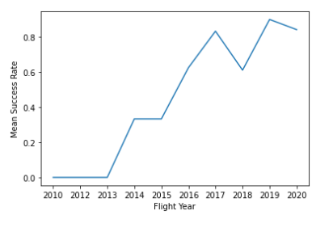
Launch Success Yearly Trend
The success rate since 2013 kept increasing till 2020.

Slide 24
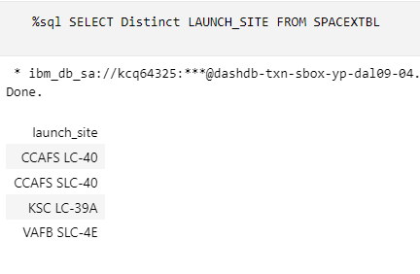
All Launch Site Names
Find the names of the unique launch sites

Slide 25
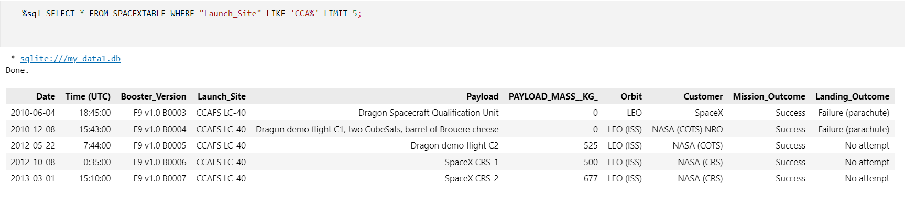
Launch Site Names Begin with 'CCA'

Slide 26
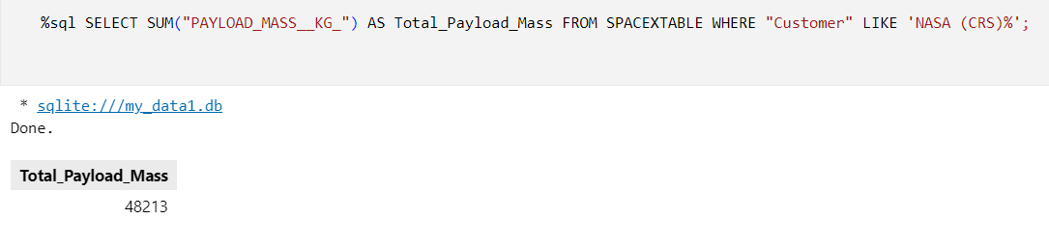
Total Payload Mass
Calculated the total payload carried by boosters from NASA

Slide 27
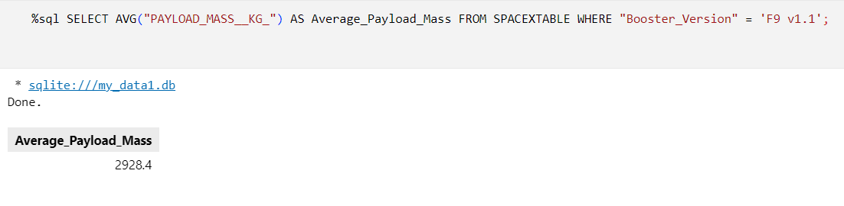
Average Payload Mass by F9 v1.1
Calculated the average payload mass carried by booster version F9 v1.1

Slide 28
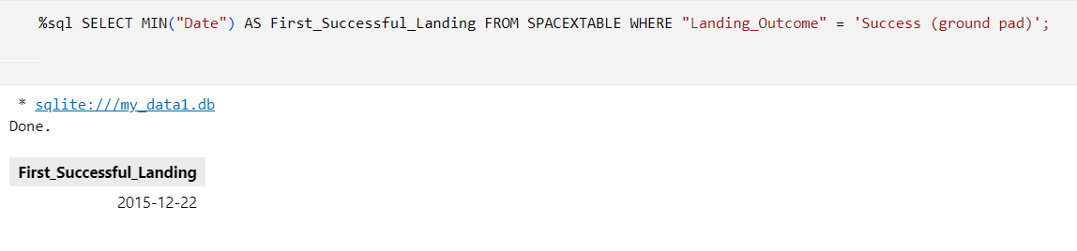
First Successful Ground Landing Date
The dates of the first successful landing outcome on ground pad

Slide 29
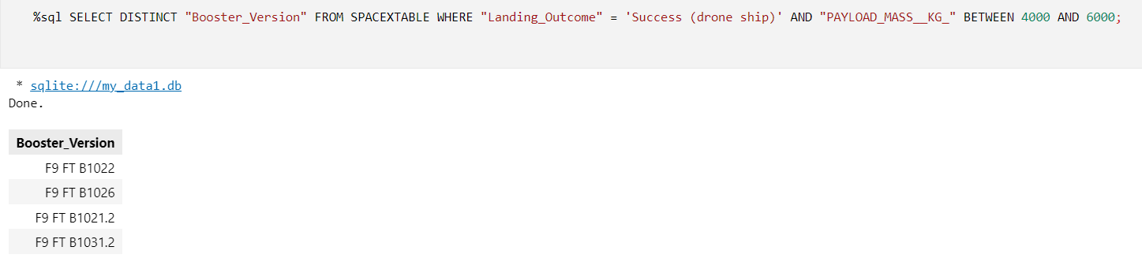
Successful Drone Ship Landing with Payload between 4000 and 6000
Listing the names of boosters which have successfully landed on drone ship and had payload mass greater than 4000 but less than 6000

Slide 30
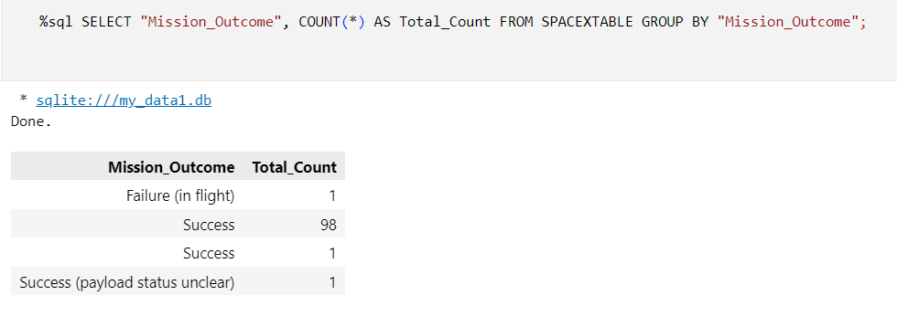
Total Number of Successful and Failure Mission Outcomes
Calculated the total number of successful and failure mission outcomes

Slide 31
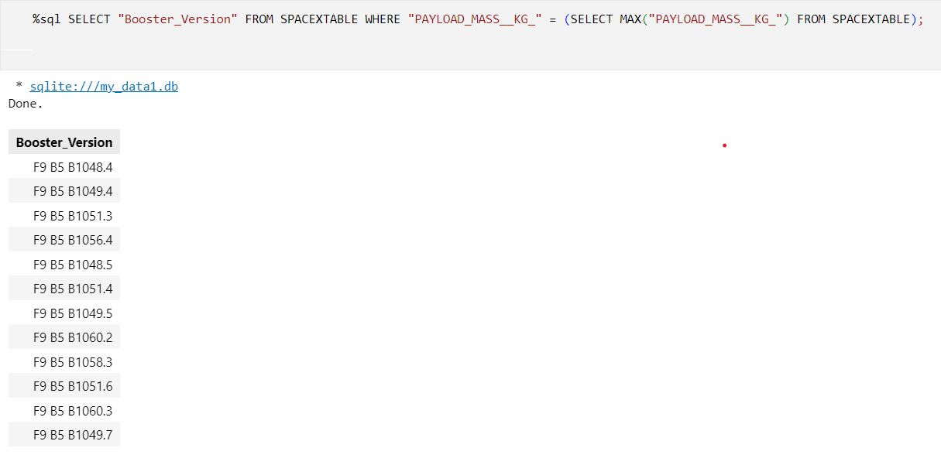
Boosters Carried Maximum Payload
Listed the names of the booster which have carried the maximum payload mass

Slide 32
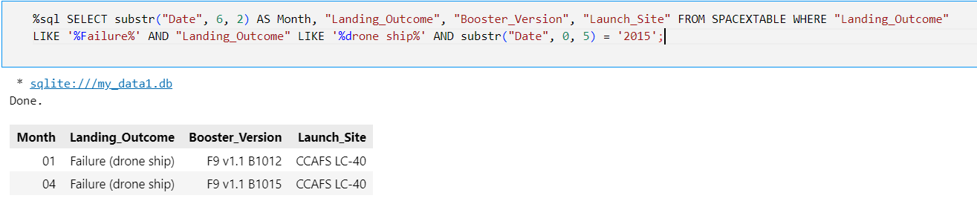
2015 Launch Records
Listed the failed landing outcomes in drone ship, their booster versions, and launch site names for in year 2015

Slide 33
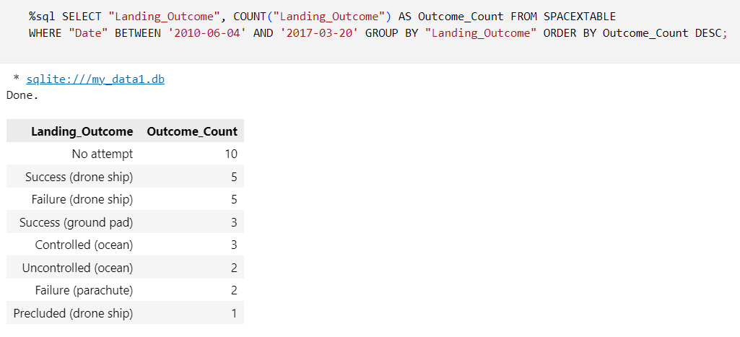
Rank Landing Outcomes Between 2010-06-04 and 2017-03-20
Ranked the count of landing outcomes (such as Failure (drone ship) or Success (ground pad)) between the date 2010-06-04 and 2017-03-20, in descending order

Slide 34


Slide 35
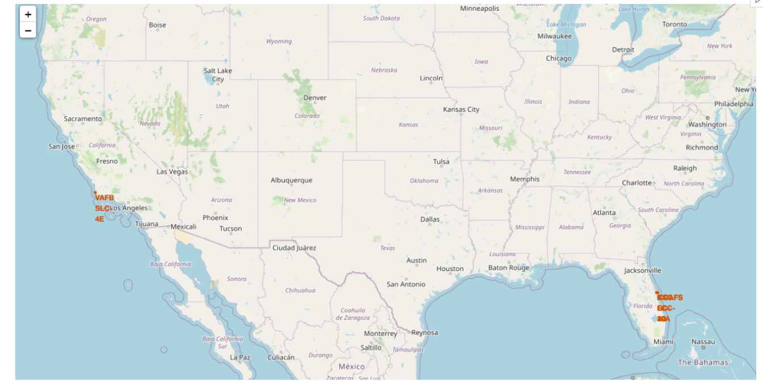
All launch sites

Slide 36
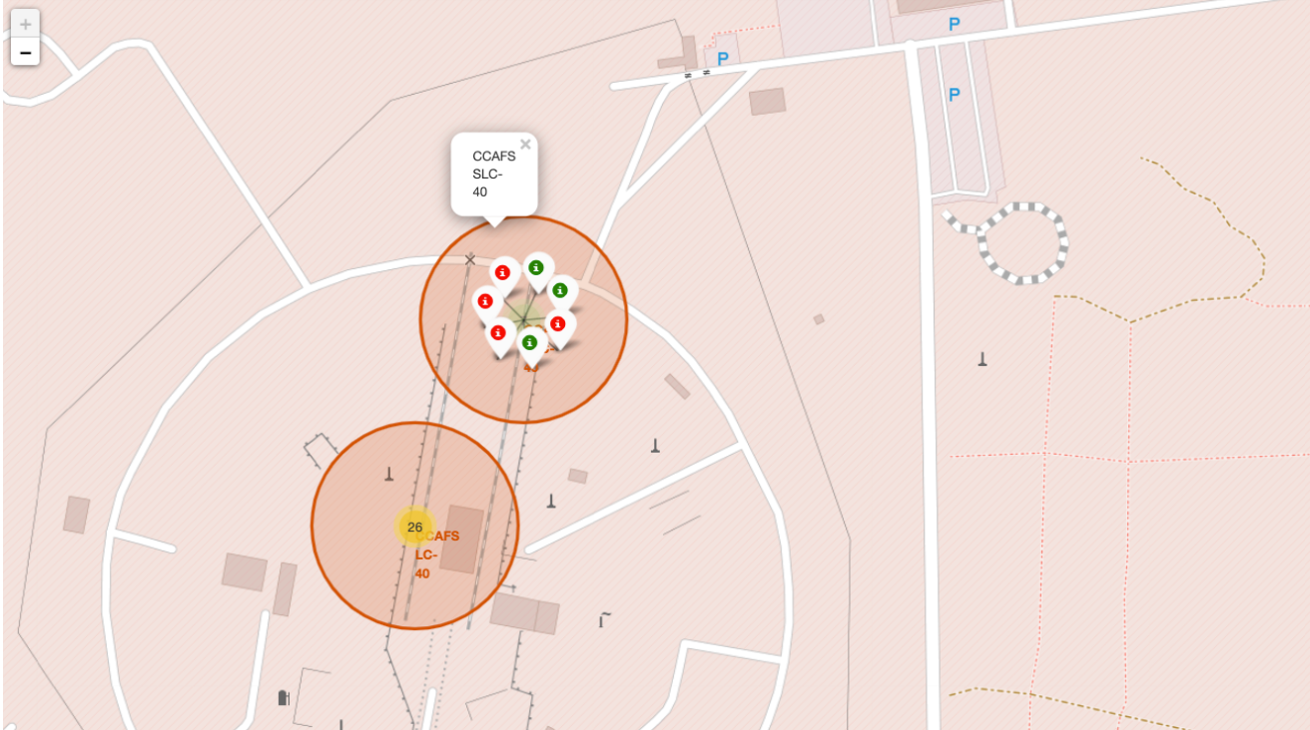
Markers showing launch sites with color labels

Slide 37

Launch Site distance to landmarks

Slide 38


Slide 39
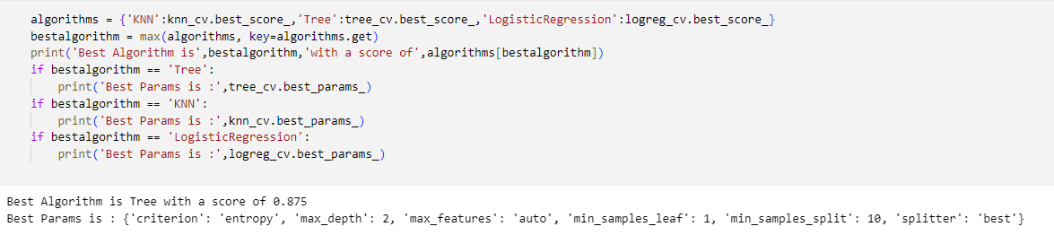
Classification Accuracy
Model with the highest classification accuracy

Slide 40
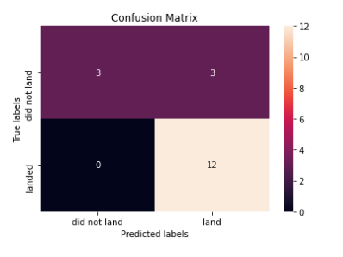
Confusion Matrix
The confusion matrix for the decision tree

Slide 41
Conclusions
We can conclude that:
The Decision Tree model emerged as the best-performing algorithm for this dataset.
Launches with lower payload mass tend to have higher success rates compared to those with heavier payloads.
Most launch sites are strategically located near the Equator and in close proximity to the coast.
The success rate of launches has shown a steady increase, particularly from 2013 to 2020.
KSC LC-39A recorded the highest number of successful launches among all sites.
Orbits such as ES-L1, GEO, HEO, and SSO demonstrated the highest success rates, with some achieving a 100% success rate.

Slide 42


